Slide 1
OMOP / FHIR Vocabulary Translations
OMOP + FHIR Terminologies Subgroup
Davera Gabriel
15Nov21

Slide 2
OMOP
FHIR

Slide 3
1
OMOP
FHIR
2

Slide 4
Source Systems EHRs, CTMS…
OMOP
FHIR
https://athena.ohdsi.org/
OMOP Concept ID
Domain
Source Vocabulary / ID
4a) Standard
b) Non-Standard
c) Classification Concept
5) Validity
6) Start / End Dates
OMOP ETL / Data Harmonization
a) Assign Domain
b) Map to OMOP Vocabulary
IPS example: “Acute myocardial infarction of anterior wall”
SNOMED CT = 54329005

Slide 5
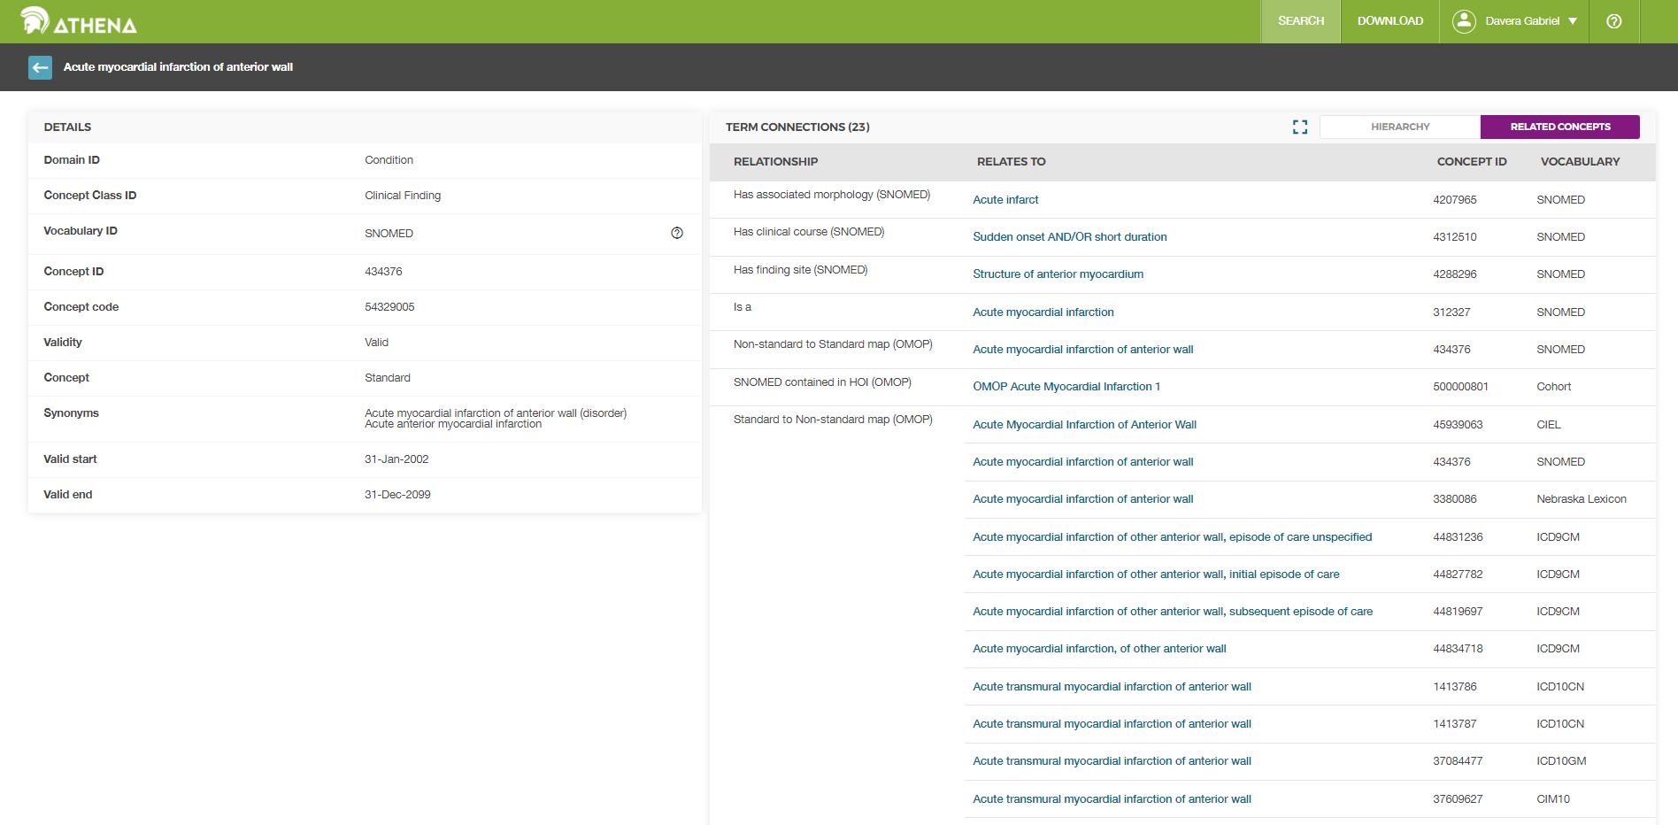
https://athena.ohdsi.org/search-terms/terms/434376

Slide 6

https://athena.ohdsi.org/search-terms/terms/434376?fullscreen=false&levels=10&standardsOnly=false&zoomLevel=4

Slide 7
Source Systems EHRs, CTMS…
OMOP
FHIR
https://athena.ohdsi.org/
OMOP Concept ID
Domain
Source Vocabulary / ID
4a) Standard
b) Non-Standard
c) Classification Concept
5) Validity
6) Start / End Dates
7) Synonyms
434376
Condition
SNOMED / 54329005
OMOP ETL / Data Harmonization
a) Assign Domain
b) Map to OMOP Vocabulary
Standard
Valid
31JAN2002 / 31DEC2099
Acute myocardial infarction of anterior wall (disorder)
Acute anterior myocardial infarction
IPS example: “Acute myocardial infarction of anterior wall”
SNOMED CT = 54329005

Slide 8
Source Systems EHRs, CTMS…
OMOP
FHIR
https://athena.ohdsi.org/
OMOP Concept ID
Domain
Source Vocabulary / ID
4a) Standard
b) Non-Standard
c) Classification Concept
5) Validity
6) Start / End Dates
7) Synonyms
45594919
Condition
ICD10CM / T82.817S
OMOP ETL / Data Harmonization
a) Assign Domain
b) Map to OMOP Vocabulary
Non-Standard
Maps to Standard: 434814
Late effect of medical and surgical care complication
Valid
1JAN1970 / 31DEC2099
Embolism due to cardiac prosth dev/grft, sequela
N3C example: “Embolism due to cardiac prosth dev/grft, sequela”
ICD10CM = T82.817S
https://athena.ohdsi.org/search-terms/terms/45594919

Slide 9
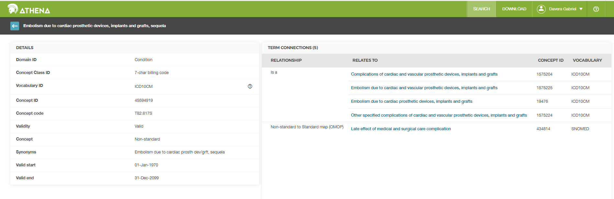
https://athena.ohdsi.org/search-terms/terms/45594919

Slide 10
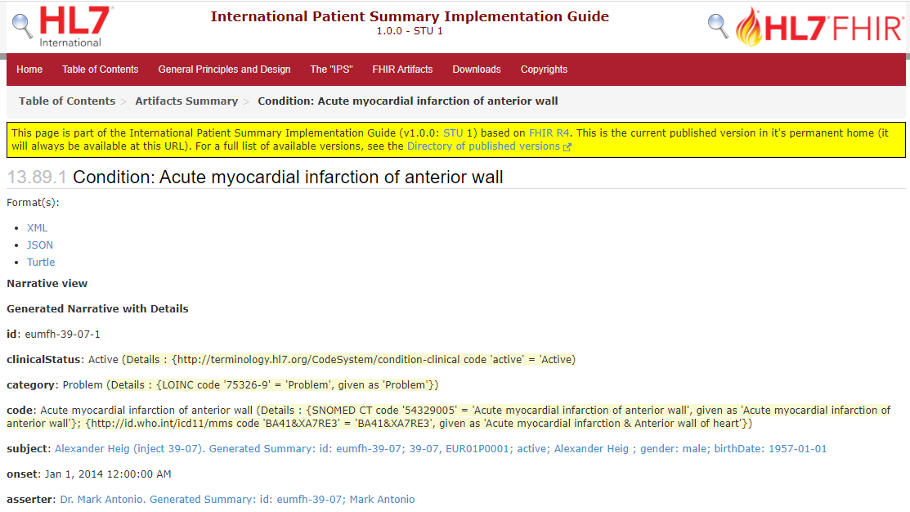
OMOP
FHIR
http://hl7.org/fhir/uv/ips/STU1/Condition-eumfh-39-07-1.html

Slide 11
OMOP
FHIR
<code>
<coding>
<system value="http://snomed.info/sct"/>
<code value="54329005"/>
<display value="Acute myocardial infarction of anterior wall"/>
</coding>
<coding>
<system value="http://id.who.int/icd11/mms"/>
<code value="BA41&amp;XA7RE3"/>
<display value="Acute myocardial infarction &amp; Anterior wall of heart"/>
</coding>
</code>
http://hl7.org/fhir/uv/ips/STU1/Condition-eumfh-39-07-1.xml.html

